Slide 1
An Introduction to Citing and Referencing: Chicago Manual Style
How do I cite this????

Slide 2
Overview
This workshop will address:
the purpose of citing and referencing in academic writing
when and how to properly cite your sources
what kinds of information require citation
how to integrate quotes and other information into your writing
basic Chicago Manual Style (CML) citation guidelines.
Note: All images were retrieved from Bing image search.

Slide 3
CITING AND REFERENCING
Proper citation/referencing has two aspects:
In-Text Citations: While most other styles use short (parenthetical) notes to indicate when an idea presented in your writing relies upon the work/thinking of another, CMS using foot notes with more detailed information.
References: Called a ‘Bibliography’ in CMS, these are presented at the very end of your work. These are detailed notes identifying the author(s), title, publisher, and any other important information about the resources you have consulted.

Slide 4
WHY
CITE?

Slide 5
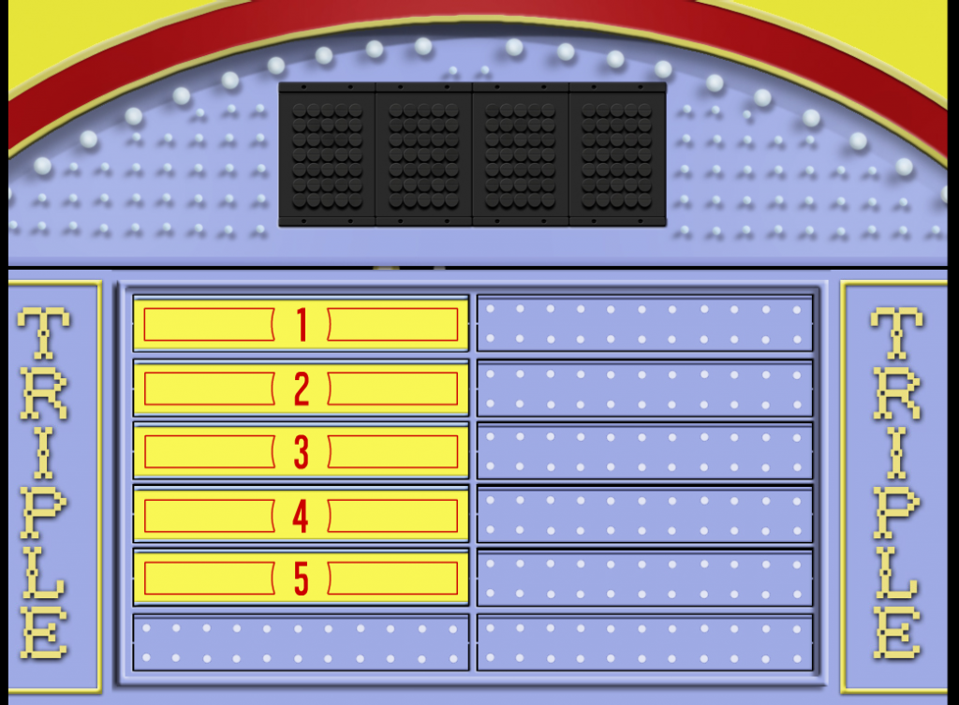
Why Do We Cite?

Slide 6
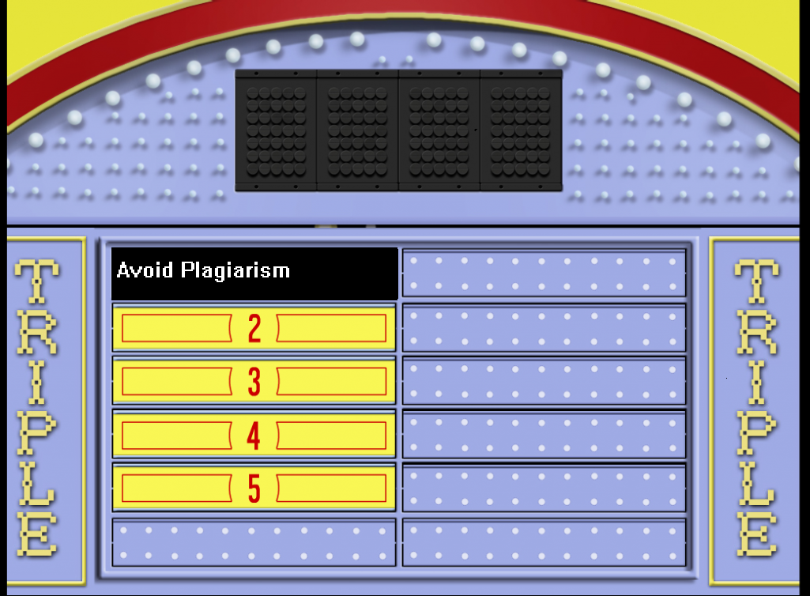
Why Do We Cite?

Slide 7
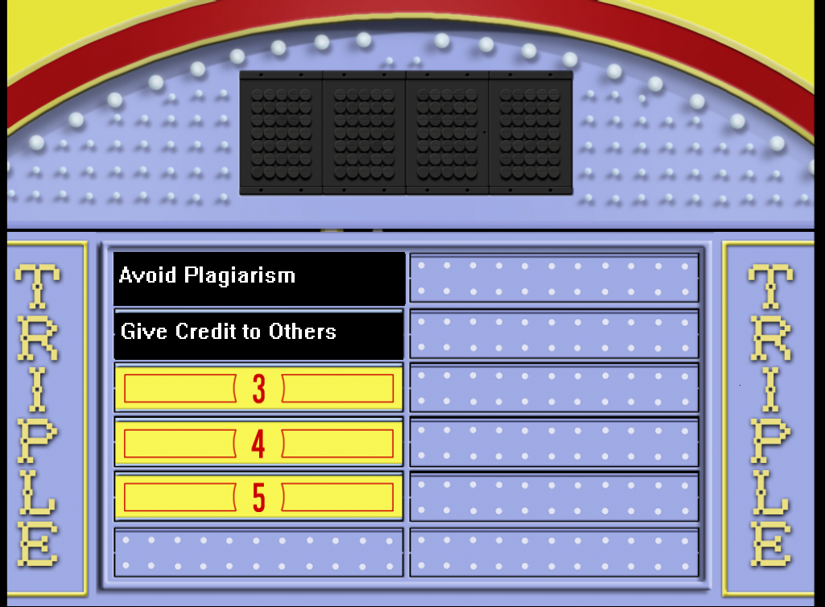
Why Do We Cite?

Slide 8
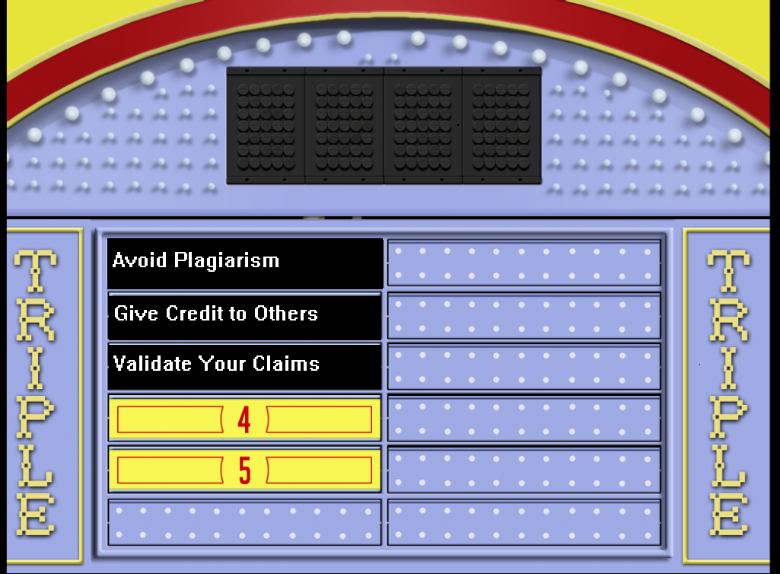
Why Do We Cite?

Slide 9
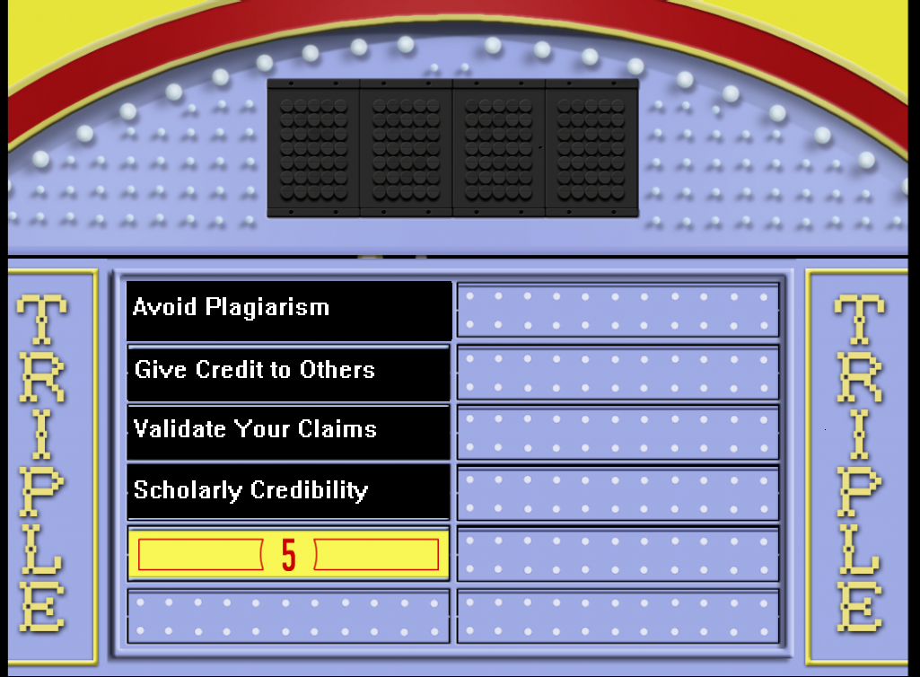
Why Do We Cite?

Slide 10
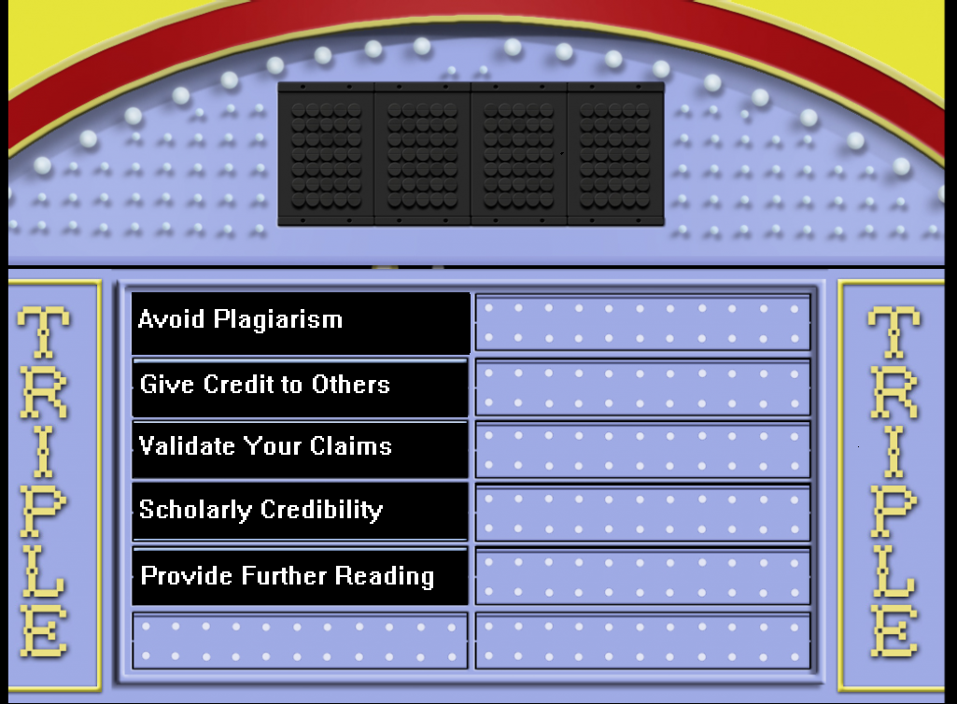
Why Do We Cite?

Slide 11
WHEN
WE
CITE

Slide 12
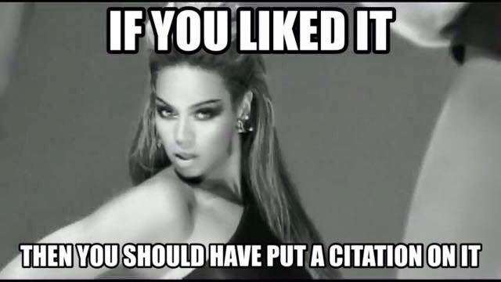
When Should You Cite?
You need to provide citations and references whenever an idea you present or statement you make is dependent on the work of others.
Cite others’ original thinking!

Slide 13
Three Instances When You Cite
Direct Quotes
Paraphrasing
Summary

Slide 14
Direct Quotation
Any time you take three significant words or more from a source, “direct quotes” should be placed around those words.

Slide 15

Paraphrasing & Summary

Slide 16
Paraphrasing
Paraphrasing
This involves presenting ideas from the source in your own words.
Simply replacing words with a thesaurus is not adequate.
This is best used when citing material written in a different tense or perspective.

Slide 17
Summary
Summary
A summary is simply an outline of the key points to an argument put in a succinct way.
For example, an article might list illnesses linked with a variable, and then define those illnesses and symptoms; you might simply list the illnesses.
This is done to minimize the number of words you use, and focus on key points relevant to your argument.

Slide 18
To Cite, or Not to Cite?
What you have to cite
Contested theories and facts
Specific words or phrases
What you don’t need to cite
Common knowledge
Uncommon facts
Images, graphs, and tables
Perspectives other than your own
Any original idea or research!
Proverbs, expressions
Common opinions
Stats

Slide 19

If you are unsure whether or not you need a citation,
cite anyway!

Slide 20


Slide 21


How to Cite: Creating a Footnote
Mac
PC
Option/Alt + Command + F
Ctrl + Atl + F

Slide 22
Rules for Multiple Authors
One-Three
Four or more
Company/Organization
Edited/Translated Works
No Author

Slide 23
1-3 authors (Footnote):
First Appearance: Kanye West and Kim Kardashian, Directions You Can Use to Name Your Children (Chicago: West Publishing, 2015), 45.
Subsequent Non-consecutive Appearances: West and Kardashian, Directions, 68.

Slide 24
Four or more authors.
First Appearance: Harry Styles et al., “Getting Over Zayn,” Boy Band Quarterly 12 no. 4 (2016): 3.
Subsequent Non-consecutive Appearances: Styles et al., Getting Over Zayn, 7.

Slide 25
Companies/Organizations (Online Book)
When the work is published by an organization, instead of an author, use the company’s name instead:
First Appearance: McDonald’s, Diabetes and Heart Disease: The Monopoly Prizes Everybody Can Win (Oak Brook: Grimace University Press), 24.
Subsequent Non-consecutive Appearances: McDonald’s, Diabetes, 27.

Slide 26
No Author
When there is no author or organization, use the title, or an abbreviation of the title, in place of the author. The title should be in “quote marks”:
First Appearance: “Why Fact-checking Is Important,” Rolling Stone, November 19, 2014, 34.
Subsequent Non-consecutive Appearances: “Fact-checking,” 35.

Slide 27
Translator or Editor instead of Author
When putting a translator or editor in place of an author, be sure to note their relationship to the work.
First Appearance: Donald Trump, ed., Facts (New York, Trump University Press, 2016), 45.
Subsequent Non-consecutive Appearances: Trump, Facts, 47.

Slide 28
Translator or Editor in Addition to the Author
When providing a translator’s or editors’ name in addition to the author, the author comes first.
First Appearance: Hilary Clinton, My Life, trans. Vladimir Putin (Moscow, The Bulshevik Propaganda Press, 2016), 23.
Subsequent Non-consecutive Appearances: Clinton, My Life, 27.

Slide 29
Note on Shortened Title
“The short title contains the key word or words from the main title. An initial A or The is usually omitted. The order of the words should not be changed (for example, Daily Notes of a Trip around the World should be shortened not to World Trip but to Daily Notes or Around the World). Titles of four words or fewer are seldom shortened. The short title is italicized or set in roman and quotation marks according to the way the full title appears.”
CMS

Slide 30
Note on Consecutive Citations
“In a departure from previous editions, Chicago discourages the use of ibid. in favor of shortened citations as described elsewhere in this section; to avoid repetition, the title of a work just cited may be omitted.”
CMS
Examples:
5. Wolff, Fire and Fury, 67.
6. Wolff, 72.

Slide 31


Slide 32
Electronic Sources
Sources without a Print Counterpart
DOI
Sources with a Print Counterpart

Slide 33
Electronic Source (with a print counterpart)
If you retrieved the source online, be sure to include a date accessed (consult your instructor on this point) and a URL.
“Electricity Is Important for Light and Heating, Brexit Reports Reveals,” The New European, December 22, 2017, http://www.theneweuropean.co.uk/top-stories/electrity-important-brexit-reports-1-5331837.

Slide 34
Electronic Source (without a print counterpart)
If you retrieved the source online, be sure to include a date accessed (consult your instructor on this point) and a URL.
Jordanfien, “Put Together an Outfit from Urban Outfitters and We'll Reveal which ‘Grey's Anatomy’ Doctor You Are,” Buzzfeed, January 4, 2018, https://www.buzzfeed.com/jordanfein/build-an-outfit-from-urban-outfitters-and-well-gi-3a55o?utm_term=.jrkpEWGvX#.qnNJAjQal.

Slide 35
Journal Articles and DOIs
Journal articles are the most common source cited in academic writings, and are usually accessed online. Unlike other online sources, they usually have a Digital Object Identifier (DOI). Include this in place of a URL.
Miley Cyrus, “The Origins of Twerking,” American Journal of Contemporary Dance, 1, no. 1 (2016): 123, doi: 210.69/57.21.17.

Slide 36

Bibliography

Slide 37
References: Authors
One to ten authors
More than ten authors

Slide 38
First author: last name first, first name last.
Each name prior to the final name is concluded with a comma.
The word ‘and’ will precede the final name if there are more than two authors.
The final name will be concluded with a period.
Include all names.
One to Ten Authors
The remaining authors: first name first, last name last.

Slide 39
One to Ten Authors
Styles, Harry, Zayn Malik, Niall Horan, Liam Payne, and Louis Tomlinson.
Example

Slide 40
More than ten authors
List the first seven authors as described in the previous slide.
The word ‘and’ will not be used to introduce the last name.
‘et al.’ will follow the seventh name and the remaining names will not be included.

Slide 41
Example
Killah, Ghostface, Method Man, RZA, ODB, Raekwon, Masta Killa, Inspectah Deck, et al.

Slide 42
“Where space is limited, the policy of the American Medical Association may be followed: up to six authors’ names are listed; if there are more than six, only the first three are listed, followed by et al.”
CMS

Slide 43
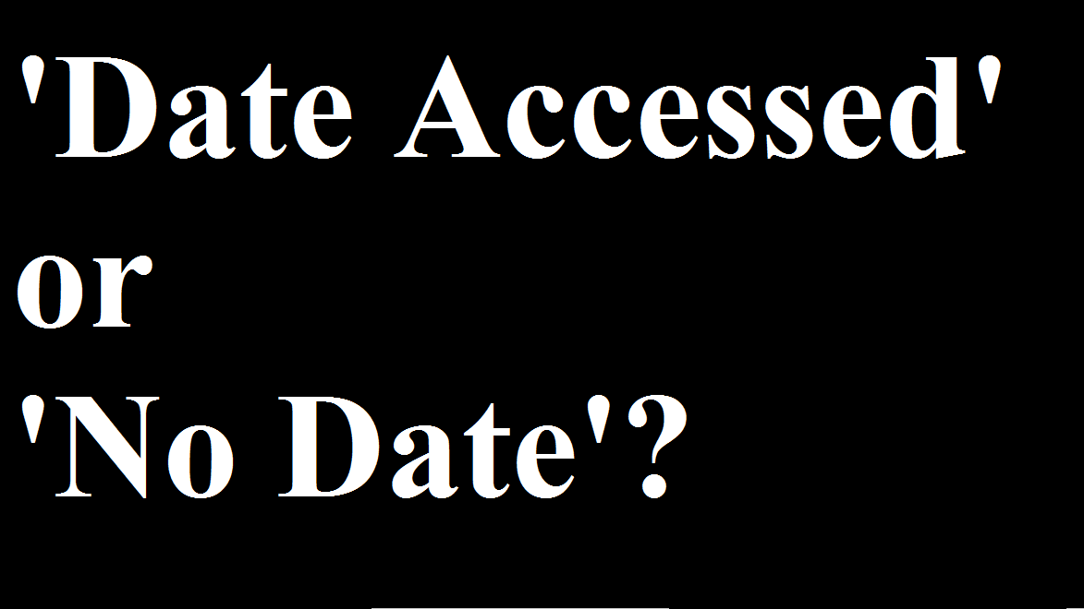

Slide 44
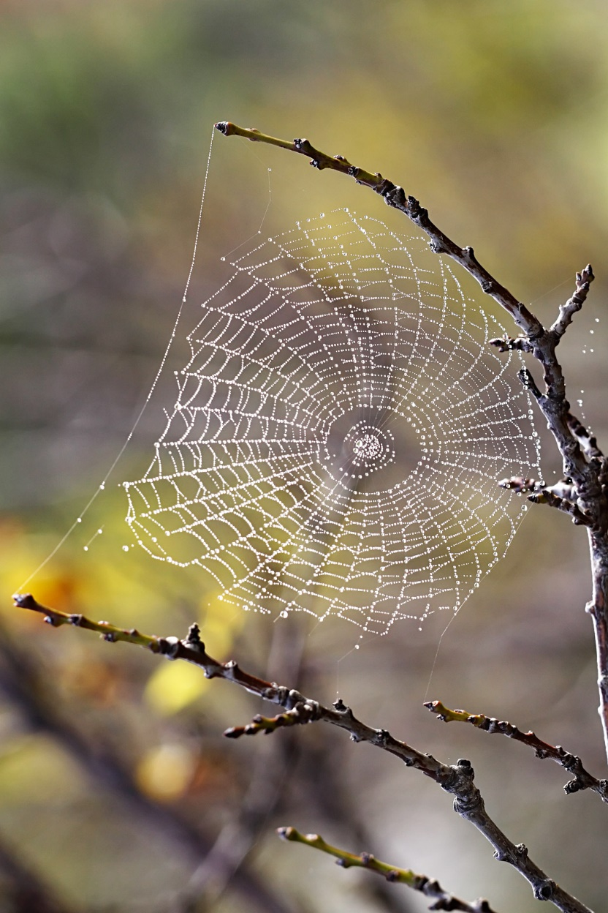
Web Sources
If you cannot find a date on a web source, or online source, use the date accessed.

Slide 45

Print Sources
If you have a print source with no date, use the abbreviation ‘n.d.’ in place of the date.

Slide 46

Preparing a Reference List: Questions To Ask Yourself
What type of source are you using?
- A book? A website? A scholarly article?
Who is responsible for the text?
- An author? A translator? An editor? An
organization?
When was the resource published?
- Year? Month? Volume? Issue?
How did you find the source?
- The Internet? In a database? In the library?
Keep track of your sources to make your reference list easy!

Slide 47


Slide 48
Example: Online Journal
Carey, Mariah.
Note: The last name comes first, followed by the first name. The middle initial or name will be include if it is part of the publish name.

Slide 49
Example: Online Journal
Carey, Mariah. “How to Enhance Live Performances
during New Year’s Concerts.”
Note: The title of the article follows, in double quotes, and also has a period within the quotes.

Slide 50
Example: Online Journal
Carey, Mariah. “How to Enhance Live Performances
during New Year’s Concerts.” Journal of Performing Arts
Note: The title of the journal will follow and will be in italics.

Slide 51
Example: Online Journal
Carey, Mariah. “How to Enhance Live Performances
during New Year’s Concerts.” Journal of Performing Arts 2, no. 10
Note: The journal name will be follow by the volume number, which has no abbreviation before it. It is followed by a comma, and then the issue number, which has an ‘no.’ before it (an abbreviation of ‘number’).

Slide 52
Example: Online Journal
Carey, Mariah. “How to Enhance Live Performances
during New Year’s Concerts.” Journal of Performing Arts 2, no. 10 (1999)
Note: The year of publication will follow the issue number and will be in parentheses.

Slide 53
Example: Online Journal
Carey, Mariah. “How to Enhance Live Performances
during New Year’s Concerts.” Journal of Performing Arts 2, no. 10 (1999): 56-77.
Note: The page range will follow the publication, and will be preceded by a colon. If this is a print source, the page range will be followed by a period, completing the bibliographic entry.

Slide 54
Example: Online Journal
Carey, Mariah. “How to Enhance Live Performances
during New Year’s Concerts.” Journal of Performing
Arts 2, no. 10 (1999): 56-77, doi: 0000000/00000.
Note: If it is an electronic source, you will be required to provide the doi. A comma will follow the page range, and then the letters ‘doi’ (in lowercase and followed by a colon) will introduce the doi.

Slide 55
Example: Online Journal
Carey, Mariah. “How to Enhance Live Performances
during New Year’s Concerts.” Journal of
Performing Arts 2, no. 10 (1999): 56-77,
http://dx.doi.org/10.1016/j.appdev.2012.05.005.
Note: If the ‘doi’ cannot be found, you can use the doi link.

Slide 56
Example: Online Journal
Carey, Mariah. “How to Enhance Live Performances
during New Year’s Concerts.” Journal of
Performing Arts 2, no. 10 (1999): 56-77, http://www.websitename.com/subdirectory.
Note: If neither a doi nor a doi link can be found, you can use the URL instead. Do not leave the hyperlink in.

Slide 57
Footnote vs. Bibliography
Footnote:
1. Mariah Carey, “How to Enhance Live Performances during New Year’s Concerts,” Journal of Performing Arts 2, no. 10 (1999): 63, doi: 0000000/00000.
Bibliography:
Carey, Mariah. “How to Enhance Live Performances during New Year’s Concerts.” Journal of Performing Arts 2, no. 10 (1999): 56-77. doi: 0000000/00000.

Slide 58


Slide 59
Example: Books
Chomsky, Noam.
NOTE: Start with the author’s last name. This is followed by the author’s first name, and then middle initials or names if included in the published name.

Slide 60
Example: Books
Chomsky, Noam. How Donald Trump Will Destroy the World.
NOTE: The title of the book will follow the name, will be written in italics, and will conclude with a period.

Slide 61
Example: Books
Chomsky, Noam. How Donald Trump Will Destroy the World. New York:
Penguin,
NOTE: The location of the publisher will follow and will introduce the name of the publisher with a colon.

Slide 62
Example: Books
Chomsky, Noam. How Donald Trump Will Destroy the World. New York:
Penguin, 2017.
NOTE: A comma will follow the name of the publisher and introduce the year of publication, which will be concluded with a period.

Slide 63
Example: Books
Chomsky, Noam. How Donald Trump Will Destroy the World. Edited by Bernie Sanders. New York: Penguin, 2017.
NOTE: If the book is an edited or translated work, the words ‘Edited by’ or ‘Translated by’ will follow the name of the book and introduce the name of the editor or translator. Their first name will appear first.

Slide 64
Footnote vs. Bibliography
Footnote:
1. Noam Chomsky, How Donald Trump Will Destroy the World, ed. Bernie Sanders (New York: Penguin, 2017), 37.
Bibliography:
Chomsky, Noam. How Donald Trump Will Destroy the World. Edited by Bernie Sanders. New York: Penguin, 2017.

Slide 65


Slide 66
Example: Chapter/Article in a Book
Lahren, Tomi. “How to Yell about Mundane Political Issues.”
NOTE: The chapter from a book will start the same way as an article from a journal.

Slide 67
Example: Chapter/Article in a Book
Lahren, Tomi. “How to Yell about Mundane Political Issues.” In How to
Get Voters Angry via Logical Fallacies
NOTE: The word ‘In’ will introduce the name of the book from which the article is taking.

Slide 68
Example: Chapter/Article in a Book
Lahren, Tomi. “How to Yell about Mundane Political Issues.” In How to
Get Voters Angry via Logical Fallacies, edited by Ann Coulter
NOTE: If it is an edited book, a comma will follow the name of the book, then ‘ed.’ will introduce the editor, whose first name will be presented first.

Slide 69
Example: Chapter/Article in a Book
Lahren, Tomi. “How to Yell about Mundane Political Issues.” In How to
Get Voters Angry with Logical Fallacies, edited by Ann Coulter,
23-50.
NOTE: A comma will follow the editor’s name and will introduce the page range of the chapter. This will be closed with a period. If there if no editor, the page range will follow the comma after the title of the boom.

Slide 70
Example: Chapter/Article in a Book
Lahren, Tomi. “How to Yell about Mundane Political Issues.” In How to
Get Voters Angry with Logical Fallacies, edited by Ann Coulter,
23-50. Dallas: Partial Press, 2017.
NOTE: The bibliographic entry will be closed the same way as a book: the location will be followed by a colon that introduces the publisher. This will be followed by a comma, and then the year of publication.

Slide 71
Footnote vs. Bibliography
Footnote:
1. Tomi Lahren, “How to Yell about Mundane Political Issues,” in How to
Get Voters Angry with Logical Fallacies, ed. Ann Coulter
(Dallas: Partial Press, 2017), 23.
Bibliography:
Lahren, Tomi. “How to Yell about Mundane Political Issues.” In How to
Get Voters Angry with Logical Fallacies, edited by Ann Coulter,
23-50. Dallas: Partial Press, 2017.

Slide 72
Hanging Line
The first line of the reference will be left aligned with no indent. The lines under the first line will all be indented. This is called a ‘hanging’ line.
To achieve this effect, do not simply hit the ‘tab’ button. Instead, highlight the entire reference page, right click, and select ‘Paragraph’.
Then, under the ‘Indentation’ subheading, open the dropdown menu. You will have three options: ‘None’, ‘First Line’, and ‘Hanging’. Select hanging, and then click ‘OK’ on the bottom right-hand corner of the pop-up window.

Slide 73
A Word About Citation Generators…
Many students use citation generators such as:
Citation Machine
BibMe
EasyBib, etc.
However, this technology is NOT foolproof, and OFTEN results in improper citations!!
You still need to know how to reference your sources properly. The best way is to check the style guide or The Purdue OWL.
Bottom Line: Know how to cite properly so you don’t end up with unnecessary mistakes in your reference list!

Slide 74
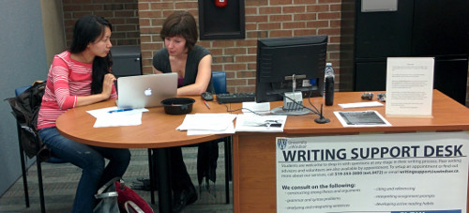
Still Have Citation Questions?
There are ways to cite every kind of published or unpublished work, no matter what the medium. If you’re not sure how to cite something, look it up on the Purdue OWL, or come see us at the Writing Support Desk in Leddy Library!

Slide 75
References
Information retrieved from:
OWL Purdue:
https://owl.english.purdue.edu/owl/resource/717/02/
Chicago Manual Style:
http://www.chicagomanualofstyle.org
http://www.chicagomanualofstyle.org/book/ed17/part3/ch14/toc.html
All image retrieved from Microsoft Office, or Bing image search.

